Slide 1
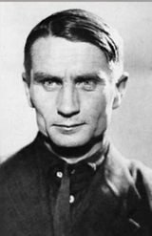
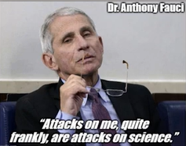
“The Sovietization of American Medicine: Fauci as America’s Trofim Lysenko” Irene Mavrakakis, M.D.

Slide 2
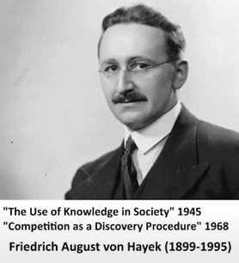
Notes:
Hi
The great ‘Austrian Economist’ and 1974 Nobel Laureate F.A. Hayek, in some of his writings like ‘The Use of Knowledge in Society’ and ‘Competition as a discovery procedure’ helped us realize that economic competition is how we discover and spread superior information throughout society. For example, a Honda engineer in Tokyo, may have invented power door locks which thanks to 'economic competition' motivated BMW, Ford, and other 'competitors' throughout the world to copy and thus spread superior information throughout the world.
This automatic mechanism of *COMPETITIVE KNOWLEDGE DISCOVERY* is "turned on" or inadvertently "emerges" from the simple concept of 'private property'.
It is the freedom of nearly 8 billion minds in their role as consumers to ‘freely trade’ their private property for what they calculate to be best that subsequently motivates companies to innovate and copy each other’s ideas. This thus inadvertently turns the entire planet into a global supercomputer via this system of ‘competitive knowledge discovery’.

Slide 3
Notes:
Government or public sector “orders” do not have the incentive structure to innovate or even copy existing innovations since the wealth that sustains them comes from taxes and not based on information that comes from superior ideas and other competitors.

Slide 4
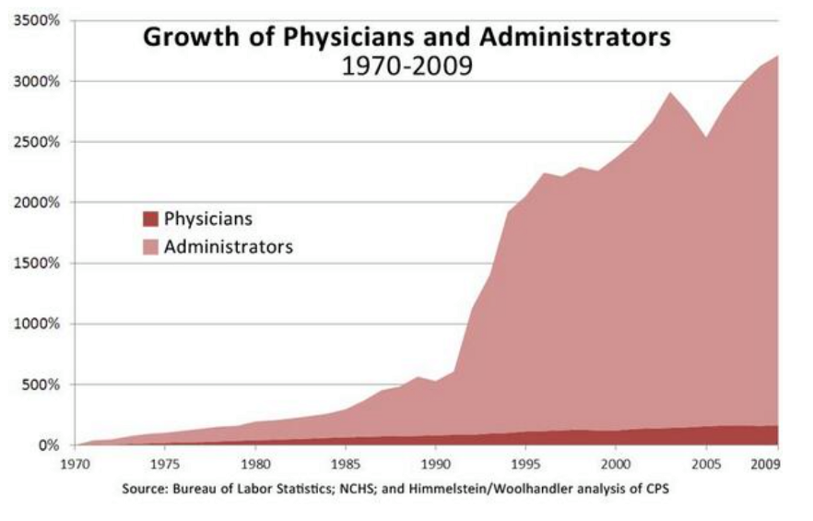
Notes:
Government regulations are coercive - competition less - monopolistic sources of information that are not subject to continuous replacement via competition so they paralyze entire industries slowing down "competitive knowledge discovery", driving up costs (more lawyers-regulators-bureaucrats), and making criminals out of people who harm nobody but just prefer to do things differently.
As this image helps illustrate, this explains why the increasingly regulated and paralyzed healthcare sector has grown from consuming 5% of the economy in 1960 to over 20% today culminating in the recent CovidMania tyranny.

Slide 5
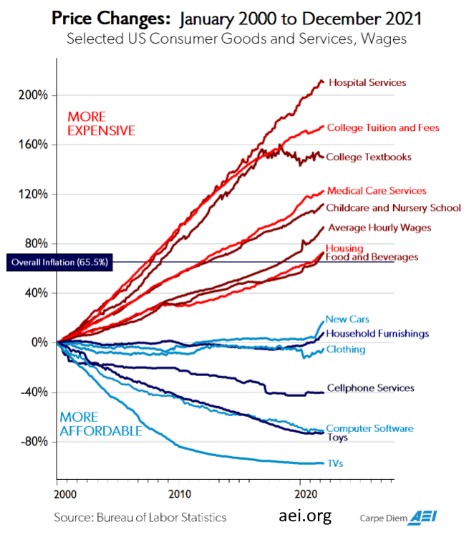
Notes:
In this image we can see how the same paralysis happens across all sectors not just medicine:
By comparison the Software-IT sector has few regulations, there is no American Computer Programmer’s Association monopolizing and paralyzing the knowledge relating to software like the CDC, FDA, NIAD, AMA and others do for medicine. Therefore, free competition motivates the creation and spread of innovations at high speed in these less-regulated sectors of society.

Slide 6
Notes:
Once again, here is the classic nighttime image of North and South Korea. We could even visualize whilst gazing at this image that information is actually moving from mind to mind as free customers and companies are constantly making comparisons and learning from each other in the South spreading superior ideas, but not in the North.
That suffices for the brief review.

Slide 7
Notes:
Mises writes:
"History speaks only to those people who know how to interpret it on the grounds of correct theories."
Once you really understand how generally speaking mankind has little idea how the economy works, and much less how, like language, ‘the market process’ which coordinates civilization has emerged independent of man's design, and how homo sapiens is intuitively communist, it becomes much easier to understand man's continuous push for disastrous central economic planning and the emergence of the Soviet Union.
The Soviet Union's rule by competition-immune "monopoly of experts-scientists" had disastrous consequences for scientific research as well.
We are fooled into believing that it is "scientists" that make our wonderful innovations, but it is not "scientists" per se, but competition which requires freedom of course, something the Soviet Union lacked leading to massive competition-immune bureaucracies that evolved to fight change and warp so-called "science" and research in ideological ways.
Once you really understand how mankind has little idea how the economy works and even more so, just like language, that the Economy has emerged independent of man's design. AND once you also realize how homo sapiens are,for the most part, intuitively communist, it becomes much easier to understand man's mistaken continuous push for disastrous central economic planning and also the emergence of the Soviet Union.

Slide 8
Trofim Lysenko (1898 – 1976)
Notes:
A particularly disastrous "scientist" who rose to the top in the 1930s was Trofim Lysenko who led a campaign against the growing field of genetics.
He had many other scientists and critics persecuted and killed, and his competition-immune theories related to farming led to millions of deaths via crop failures both in Russia, and later in China. This helped lead to the Great Chinese Famine which claimed 15-55 million lives. Lysenko mistakenly or fraudulently claimed that via a technique referred to as vernalization crop yields could be vastly improved.

Slide 9
Notes:
An article by Morgan Dunn discusses his failed thinking:
“For starters, he believed that plants and seeds could be trained to follow socialist organizational principles. His theory, which would eventually be dubbed Lysenkoism, stated that crops could be trained to conform and produce vast yields almost from out of thin air. According to what he called “the law of the life of species,” seeds wouldn’t compete with one another, but rather they would cooperate with each other in a near-sentient fashion — like humans.
Applying the Marxist principle of materialism, in which the conditions surrounding an individual dictate its behaviors and responses, Lysenko believed that plants and animals, too, could be reshaped as needed”

Slide 10
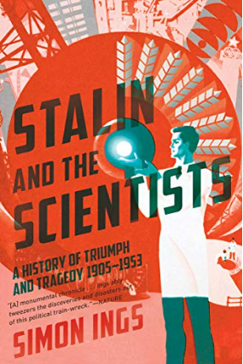
Notes:
Author Simon Ings, who wrote the book 'Stalin and the Scientists’ describes the failure of vernalization:
"The overarching problem was the amount of labor involved in vernalising an entire crop. Seeds had to be soaked in a shed for several days.You didn’t just dump them in a pile and water them. You had to spread them out, on the floor or in trays, and turn them over constantly. The work involved was herculean… “ End of quote.
To summarize, vernalization was a disaster. It led to far more consumption of wealth than production, thus shrinking the Russian and Chinese social orders by millions of people.
Being a favorite of Stalin and also on good terms with his successor Nikita Khrushchev, it wasn't until Khrushchev's downfall in 1963 that Lysenko was thoroughly discredited.
In 1964, physicist Andrei Sakharov spoke out against Lysenko in the General Assembly of the Academy of Sciences of the USSR:
He is quoted as saying :
“He ( Lysenko ) is responsible for the shameful backwardness of Soviet biology and of genetics in particular, for the dissemination of pseudo-scientific views, for adventurism, for the degradation of learning, and for the defamation, firing, arrest, even death, of many genuine scientists.”
Let us now briefly discuss how Medicine in the USA has been following a similar path as in the former Soviet Union with the rise of Anthony Fauci as our Lysenko.

Slide 11
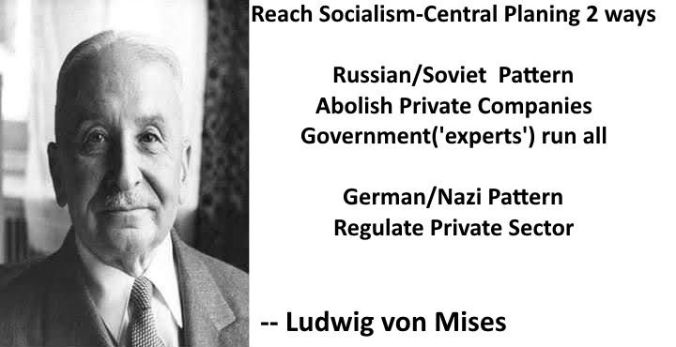
Notes:
There are two ways to destroy the 'competitive knowledge discovery' that orders civilization. Mises identified these as the Marxian or Soviet style where private enterprise is quickly abolished and replaced by government, or the German or Nazi style where increasing government regulations and thus central planning edicts, instead of private sector ‘competitive knowledge discovery’, increasingly determine how things are done. The US medical sector has gone towards the German/Nazi pattern slowly over time.

Slide 12
Rockefeller-funded Flexner report increased government regulation.
Rockefellers also funded Mises’
writings
Notes:
A major leap in government regulation of medicine occurred thanks to the Rockefeller-funded Flexner report. Paul Starr writes in his book 'The Social Transformation of American Medicine':
"the report was the manifesto of a program that by 1936 guided $ 91 million from Rockefeller’s General Education Board (plus millions more from other foundations) to a select group of medical schools."
Murray Rothbard elaborates:
"The result: every medical school and hospital was subjected to licensing by the state, which would turn the power to appoint licensing boards over to the state. The state was supposed to, and did, put out of business all medical schools that were proprietary and profit-making, that admitted blacks and women, and that did not specialize in orthodox, “allopathic” medicine: particularly homeopaths, who were then a substantial part of the medical profession, and a respectable alternative to orthodox allopathy."
Government licensing just means the abolition of 'competitive knowledge discovery' in the field being licensed. Now, it is important to NOT see the Rockefeller foundation at the time as some sinister cabal of malicious people. The very same Rockefeller foundation that pushed for such government involvement in medicine also financed the writings of Ludwig von Mises, and has been involved in countless beneficial charitable works. As with Socialism in general, as well as Catholic oppression of centuries ago, these actions leading to coercion and eventual calamities should not be seen as simplistic conspiracies when they are in fact much more complex social growths.

Slide 13
Good intentions using competition-immune government coercion makes things worse.
Socialism, Religious coercion, Medical Regulation thus coercion…. All create a less prosperous order compared to the freer alternative.
Notes:
Although it is widely known that medical error is the third leading cause of death in the US, taken as a whole, regardless of the genuine good intentions of many doctors, American doctors in general, by ignorantly supporting the various competition-immune top-down bureaucracies like the CDC, AMA, FDA, and NIAID, they themselves are in fact the leading cause of death.
Let me reiterate, as with well-intentioned Socialist ideologues or Catholic Church inquisitors, American doctors, by inadvertently stifling freedom and superior 'competitive knowledge discovery’ ARE! the leading cause of death compared to the freer alternative.

Slide 14
Notes:
Consider the following. Aggressive fasting, for example, eating a single low-carbohydrate meal every day for a month will reverse or greatly alleviate type 2 diabetes for many people among countless other benefits. This is well known in the increasingly popular low-carb, keto, and intermittent fasting world. Dr. Jason Fung's book 'The Diabetes Code' and its fasting-to-reverse-diabetes advice is a constant best-seller in numerous categories on Amazon.com. Only something akin to a Priesthood neglecting criticism of its myths can neglect the above, and this is precisely what happens with much of nutrition and especially the simple cure to type 2 diabetes. There is no mention about fasting to improve type 2 diabetes in the American Diabetes Association website just like the Soviet bureaucracy was not motivated to hand out copies of Mises’ and Hayek’s books.
The economically ignorant public believes that regulations in medicine are needed to prevent malicious quackery, but the most truly sinister and malicious snake-oil-salesmen in the private sector could never have locked down the planet and coerced millions into mask-wearing and injecting themselves with bullshit as has just happened.
I'd like to reiterate one of the themes of our event. Where there is complexity there is mythology. It would be a monumental error to say that Catholic oppression of the 1400s, or Communist oppression, were the result of malicious conspiracies, they arose thanks to the complexity of various fields and man's general ignorance of how freedom leads to prosperity.

Slide 15
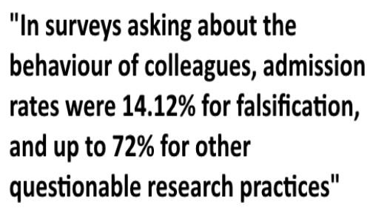
Notes:
Next consider the following, one study of scientific misconduct estimates that about 2% *"of scientists admitted to have fabricated, falsified or modified data or results at least once –a serious form of misconduct by any standard– and up to 33.7% admitted other questionable research practices. In surveys asking about the behaviour of colleagues, admission rates were 14.12% ... for falsification, and up to 72% for other questionable research practices...Considering that these surveys ask sensitive questions and have other limitations, it appears likely that this is a conservative estimate of the true prevalence of scientific misconduct." (Fanelli)
There are about 1 million doctors in the USA and 7 million scientists and engineers for a total of 8 million. 14.12% is a whopping 1.13 million scientists and docs who are out there maliciously looking to exaggerate, lie, etc. to get government grants-influence-fame and so on, and another whopping 5.76 million (72% of 8 million) who are aware of blatant corruption. So year after year 1.13 million potential charlatans and or exaggerators are out there recognizing and affiliating with other fraudsters to various degrees, statistically guaranteeing that eventually somebody is going to hit it big and potentially mislead a large portion of the scientific community.
Just one example of someone who got caught is Yoshitaka Fujii from Japan, an anesthesiologist, who "was found to have fabricated data in at least 183 scientific papers, setting what is believed to be a record for the number of papers by a single author requiring retractions. A committee reviewing 212 papers published by Fujii over a span of 20 years found that 126 were entirely fabricated, with no scientific work done. Only 3 were found to be valid. He was also found to have forged the signatures of scientists he listed as co-authors without their knowledge".
Diederik Stapel, professor of Social Psychology at Tilburg University and the University of Groningen, after getting busted wrote about his numerous data forgeries. Nick Brown translated from Stapel’s book:
"In the privacy of my office or my study at home, I did some things that were terrible, maybe even disgusting. I faked research data and invented studies that had never happened. I worked alone, knowing exactly what I was doing, and my solitary drive to achieve led to my becoming ever more detached from myself and my emotions. I didn’t feel anything: no disgust, no shame, no regrets."

Slide 16
Notes:
We now get to Fauci. What about Fauci? Fauci is just a fellow homo sapiens, a product of the prevailing central-planning myths of our times. Once we understand the socioeconomic forces creating civilization, the emergence of these catastrophic central planners becomes trivial. Jorge already brought up these great Hayek quotes but their wisdom needs to be reiterated. Hayek writes:
“It is necessary to realize that the sources of many of the most harmful agents in this world are often not evil men but high-minded idealists, and that in particular the foundations of totalitarian barbarism have been laid by honorable and well-meaning scholars who never recognized the offspring they produced.”

Slide 17
Notes:
Hayek again:
"Most people are still unwilling to face the most alarming lesson of modern history: that the greatest crimes of our time have been committed by governments that had the enthusiastic support of millions of people who were guided by moral impulses. It is simply not true that Hitler or Mussolini, Lenin or Stalin, appealed only to the worst instincts of their people: they also appealed to some of the feelings which also dominate contemporary democracies." (Hayek F. A., 1976, p. 134)
How much of the tyranny and suffering Fauci has caused is due to genuine intellectual error, various degrees of negligence, or heaven-forbid clearly malicious self-serving malice is obviously hard to know.

Slide 18
Notes:
We now apply the wisdom to the CovidMania calamity. What follows in the rest of my presentation is just one example of how competition-immune bureaucrats neglected superior ideas as they wrecked the lives and wellbeing of billions.
Having our own competition-immune top-down bureaucracies like the CDC, AMA, FDA, and NIAID we too suffer a massive lack of innovation in medicine and evolve our own Lysenkos with Anthony Fauci being the perfect example.
The Fed Government (a coercive competition-immune-monopolistic bureaucracy) should have no power over health care or any other public health or public safety matter, as this authority simply does not exist and was delegated to the states or the people in the 10th amendment. Public health and public safety were not intended as federal authorities, but to be left to states, or the people. Either way, no national government should be making healthcare decisions for individuals, nor forcing policies on businesses, and thus should not be destructive of the competition that arises from freedom.
It could be argued that the CDC itself is unconstitutional. It only exists and continues to grow based on great depression era SC rulings, permissiveness by the states, and scare tactics. Notwithstanding the fact that the CDC is partly privately funded by the industry via the CDC foundation that served to financially benefit from vaccine mandates and the like. Additionally, the CDC extended past its authorizing regulations. The CDC’s actions during COVID, notably an eviction moratorium decree, expanded any conceivable understanding of what the CDC should be able to do under current regulation.
The concept of informed consent and the lack of its use during the pandemic is a major crux of the problems of the handling of the pandemic.
Informed consent is the vital freedom from which emerges the necessary ‘competitive knowledge discovery’ needed to motivate the emergence and spread of superior treatments.
Informed consent by its inherent nature is a competition rich process whereby the physician or healthcare provider reviews risks and benefits and also their expertise, and the patient then chooses whether the risks are worth the benefit and whether that doctor or healthcare person performing that procedure or intervention is who they calculate to be the best.
The concept of informed consent as it relates to medical procedures and interventions is inherently tied to our bodily autonomy and the right to life liberty and pursuit of happiness. It is absurd and clearly tyrannical to make a person a criminal for refusing a medical treatment.
Informed consent is an important concept and is considered a requirement for the delivery of standard of care. The information provided during the process of informed consent requires the ability to fully understand the potential short and long term consequences. Informed consent also necessitates the ability to decline without force or coercion.
The mishandling of the COVID Pandemic is a quintessential example of failed central planning and the inappropriate interrelationship between governmental entities, the pharmaceutical industry, the public health sector, and medical research sector.
What went wrong? How the stage was set.
1.HR5546 - the law in 1986 that was passed that removed all product liability from vaccine makers and established VAERS and the healthcare compensation fund for which 7 billion dollars has been paid out through Federal vaccine court for vaccine injuries Before COVID. According to its own analysis though the Lazarus report only 10% of vaccine injuries are reported. This law needs to be repealed
2. THE PREP act for covid removed all product liability for vaccine/biologic makers and removed all liability from anyone administering the vaccines.
These two laws which are quintessential examples of governmental interference removed competitive incentives in the Vaccine and biologics market. The clinical trials showed significant issues with efficacy and adverse events. However, since there was no product liability there was no incentive for the pharmaceutical companies to not launch these products. These products should have never been given to humans. This all together with the many assumptions of purported safety and efficacy by the decision makers, healthcare providers, politicians, businesses and that because these biologics/vaccines were given EUA approval that they were safe and effective led to a massive error with the release of these vaccines upon the populace.

Slide 19
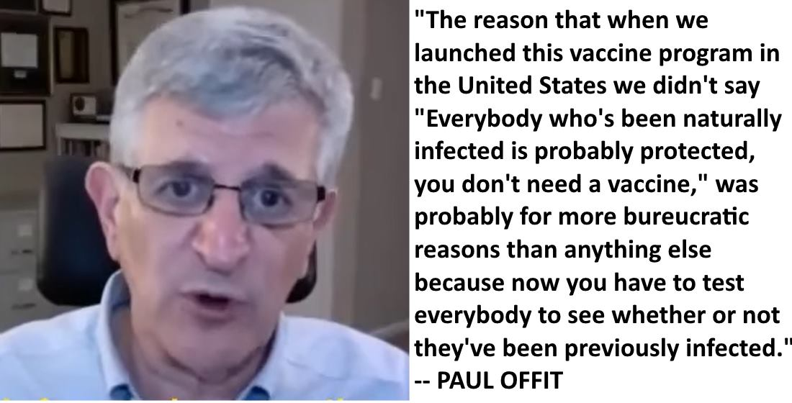
Notes:
From a medical perspective we can see many problems with the handling of the pandemic
We have always known respiratory viruses mutate and therefore vaccinating for known to mutate respiratory viruses during a pandemic is questionable science at best.
Ignoring natural immunity which is 27 times more protective and additionally not even testing for it and vaccinating those with likely natural immunity is also questionable science at best.
The influenza vaccine increases coronavirus susceptibility by 36% according to a 2018 DOD study .
Studies have shown that yearly flu vaccine is leading to inadvertent production of IGE to the flu viral antigen and preliminary studies are showing that a component of the cytokine storm for the vaccinated is also IGE mediated, likely a consequence of repetitive injection leading to inadvertent sensitization. Think about the idea that some people who get stung by bees develop bee sting allergy.
It is not lost on me and thousands of other physicians that you cannot get EUA approval for vaccine /biologic if there are medications to treat.
There were many studies that showed that Ivermectin and hydroxychloroquine/zinc were safe and effective.
Yet there was a systematic demonization of its off label use. Off-label use is necessary for new diseases . ASA is off label for HEART attack prevention.
Vitamin D levels above 50 ng/ml were known to significantly decrease morbidity and mortality were largely ignored
We could have promoted preventative nutraceuticals, vitamin D, Vitamin C, Quercitin, early treatments but this was largely demonized and ignored by the Public health officials.
The overarching theme of Pharmaceutical companies influence in MSM advertising, which approaches 70 %, their product liability protection, and their lobbying influence in our legislature has led to a dangerous situation for our country, in particular public health.
AND! Ultimately, senior Biden medical advisors like Paul Offit clearly admit that most Americans were coerced into taking the Covid Biologics/Vaccines due to ‘bureucratic reasons’. In his own words:
“The reason that when we launched this vaccine program in the United States we didn't say 'Everybody who's been naturally infected is probably protected, you don't need a vaccine,' was probably for more bureaucratic reasons than anything else because now you have to test everybody to see whether or not they've been previously infected. “

Slide 20
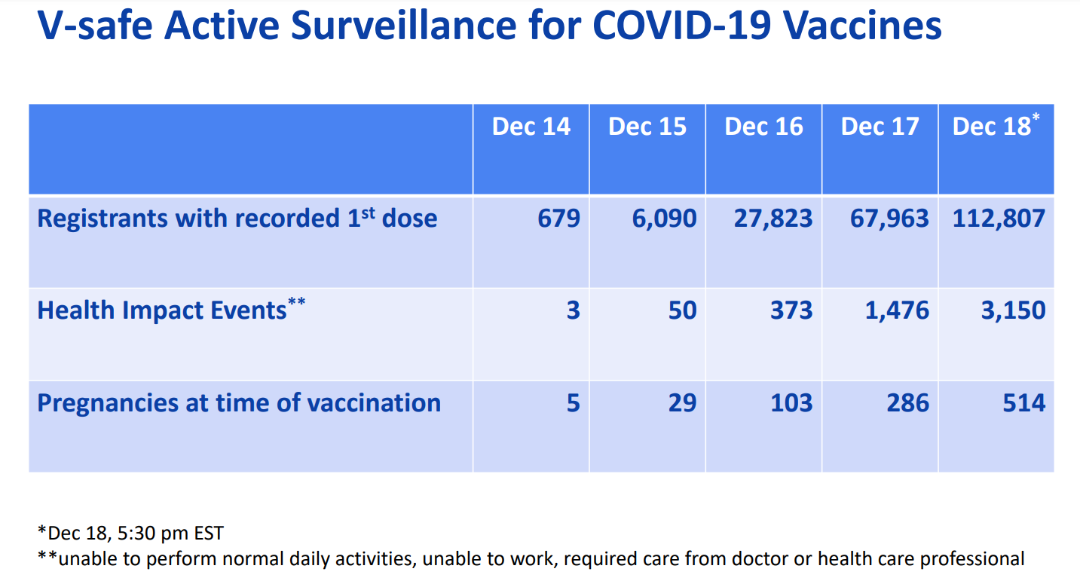
Notes:
The vaccine is an obvious calamity. By as early as 12/20/2020 according to the CDC 1 out of 35 people taking Covid vaccines are being incapacitated to the point where they are "unable to perform normal daily activities, unable to work, required care from doctor or health care professional" . About 270 million Americans got at least one dose, that means that almost 8 million Americans were noticeably injured to the point where they were "unable to perform normal daily activities, unable to work, required care from doctor or health care professional"

Slide 21
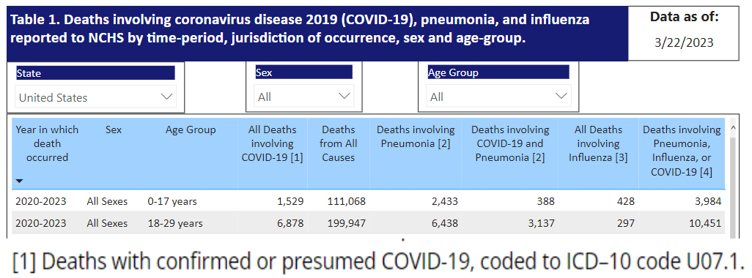
Notes:
The image here tells you everything you need to know about the incompetence and negligence of today’s medical profession. In over 3 years of CovidMania , in a population of 73 million people under 18, 1,529 have died with a positive Covid19 test thus with ‘confirmed or presumed Covid-19… That is about 500 people per year in a population of 73 million people. So 0.00000684931 of the population under 18 dies with a positive covid test, NOT even due to covid…. Just with a positive covid test…. And based on this ridiculous number, Fauci, and the medical priesthood of scientism, are coercing millions of kids to get injected with this bullshit. And forcing taxpayers to make billionaires out of the most negligent SOBs in the world.

Slide 22
Notes:
What should we do ?
What we really need is not necessarily the right answers, but the public’s understanding of how freedom and resulting ‘competitive knowledge discovery’ is what will provide the best means of discovering them. That is #1, none of these government-created calamities would have occurred had people understood real free-market economics.
Recall COVID and Flu vaccines as respiratory virus vaccination risks and benefits as well as safety and efficacy needs to be re assessed.
Re-introduce competition in healthcare and medical research by abolishing the government interference that regulates and thus paralyzes the ‘competitive knowledge discovery’ that is the key to innovation and bringing down costs. Just like the poorest of Americans can afford a cell phone that does amazing things that even a billionaire could not even imagine 20 years ago due to the lack of regulation and government involvement in the IT sector, so would the poorest of Americans easily be able to afford amazing healthcare if we likewise removed paralyzing regulations.
Eliminate revolving door leadership positions in public health and pharmaceutical companies and eliminate regulatory capture.
The fact of the matter is that the pharmaceutical companies who made these vaccines/biologics have made billions upon billions with no product liability since 1986 due to the laws that protect them even though there are known significant adverse events. They have been fined millions for safety infractions but with billions made per year it is simply the cost of doing business
Then, they take their profits and become the main advertising of mainstream media (almost 70% of the ad content) and donate money to your legislators to influence policy that led to the forcing and coercing of an experimental COVID biologic /vaccine that harmed and killed many.
Remember as well schools require other vaccines and during COVID it was coerced and forced across the nation - colleges, businesses, healthcare, etc.
It is government regulations including vaccine mandates for children that give the money to these pharmaceutical agencies.
We must repeal HR 5546 the 1986 law that removed all product liability and the Prep act that removed all product liability for vaccine/biologic makers and the doctors and healthcare workers that administered the COVID vaccine and biologics
Repeal these laws and then the pharmaceutical companies won't have all that money to influence the clueless Mainstream media and your legislators .
Health and wellness lies in the maintenance of the biochemical order of the human body through nutrition and elimination of toxins. Root cause analysis of lack of homeostasis in every patient with maximization of nutrition and detoxification is needed.
Remember We should always FIRST do no harm.

Slide 23
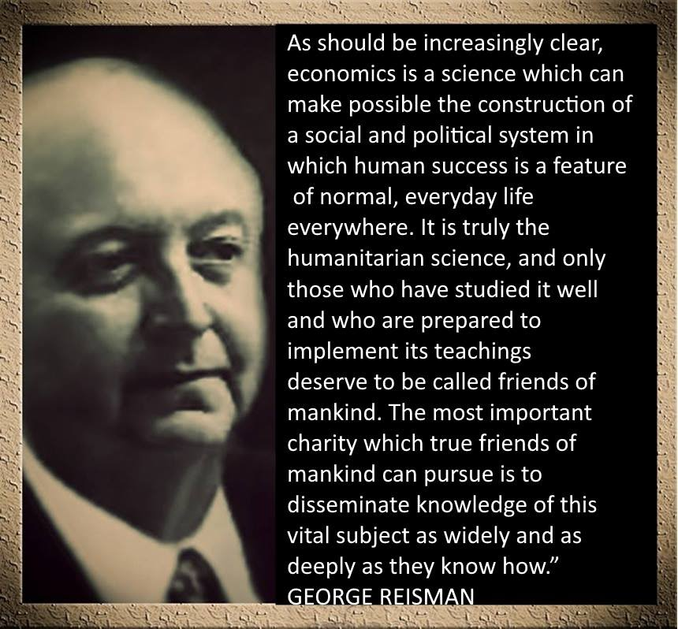
Notes:
Again, this must be emphasized: none of these government-created calamities would have occurred had people understood real free-market economics. Thus I’ll conclude with this wonderful quote from Mises’ student George Reisman:
“The solution to the present problem of massive, overwhelming poverty is nothing other than the science of economics. As should be increasingly clear, economics is a science which can make possible the construction of a social and political system in which human success is a feature of normal, everyday life everywhere. It is truly the humanitarian science, and only those who have studied it well and who are prepared to implement its teachings deserve to be called friends of mankind. The most important charity which true friends of mankind can pursue is to disseminate knowledge of this vital subject as widely and as deeply as they know how.” – George Reisman

Slide 24
Notes:
Woops… I lied, there is always time for Mises quotes:
“Economics deals with society’s fundamental problems; it concerns everyone and belongs to all. It is the main and proper study of every citizen.”—Ludwig von Mises
“Economic history is a long record of government policies that failed because they were designed with a bold disregard for the laws of economics.”—Ludwig von Mises
And finally.
“forgive them, for they do not know what they are doing.”—Jesus Christ

